Slide 1


MCQ Answer Script Marking (OCR)

Slide 2
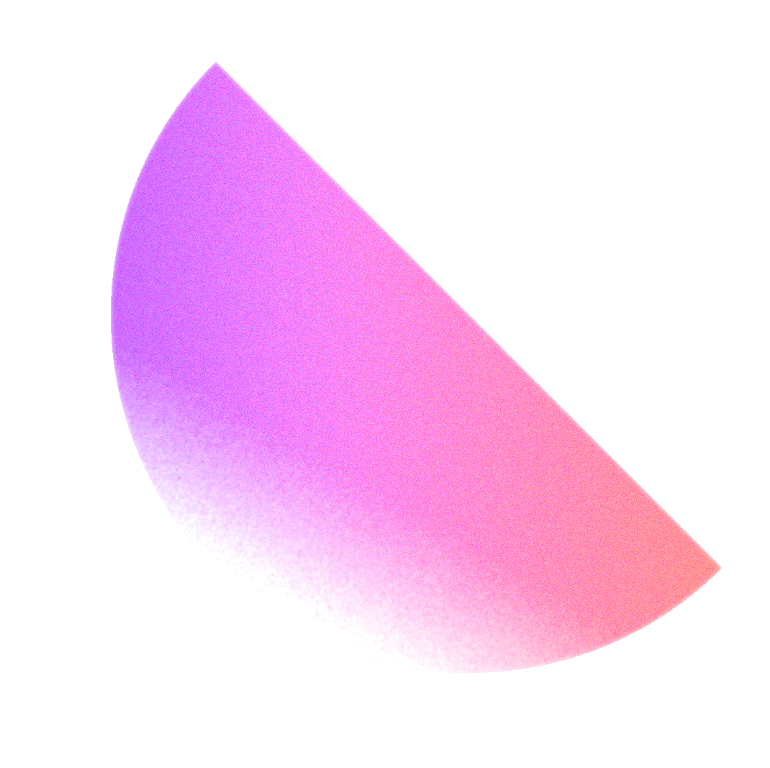

What will be presented
Project brief and objectives
Methodology
Results
Conclusion

Slide 3
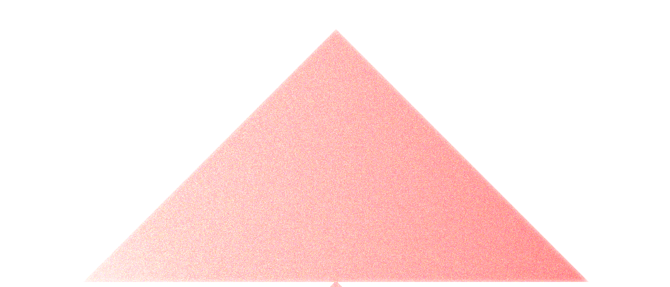
The project and its objectives
Project brief
Python and OpenCV based project.
Program accepts a picture of an answer script.
Detect rectangles and then marks on the selected areas.
Gives the marks out of 100%.
Marks the correct and wrong answers on the image.

Slide 4
Objectives
Try to implement a OpenCV based real-time MCQ marking system design
Reduce the time takes to markup the answer scripts
Reduce the mistakes that can happen when marking manually
Can use in any laptop / device that can run python

Slide 5
METHODOLOGY
Common operators
Grayscale conversion, resizing the image, and imshow (show output image)
Canny operator
imgCanny = cv2.Canny(imgBlur, 10, 70)
Canny operator used to identify the edges main parts of the image.
Because Canny uses hysteresis thresholding and non-maximum suppression, the resulting edges are usually thinner and more linked.

Slide 6
METHODOLOGY
Find contours
contours, hierarchy = cv2.findContours()
Find all the available contours
rectCon = tools.rectContour(contours)
Find and get array of all the rectangular contours

Slide 7
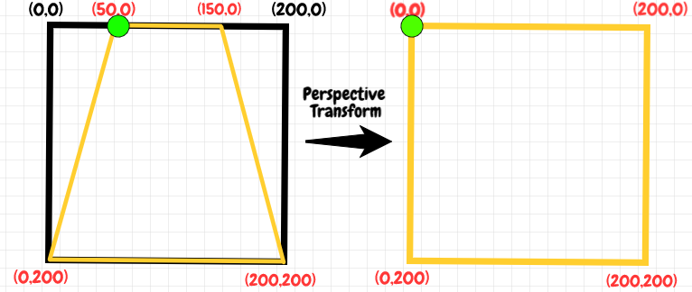
METHODOLOGY
Warp transformation
cv2.getPerspectiveTransform()
cv2.warpPerspective()
cv2.getPerspectiveTransform() -> use to get transformation matrix
cv2.warpPerspective() -> apply warp transformation
Warp transformation use to change the image shape

Slide 8
METHODOLOGY
Threshold
cv2.threshold()
Apply threshold on selected area of the images.
Make it easy to identify the OCR marks on the image
Add weighted
cv2.addWeighted()
Use to multiply image with original image

Slide 9
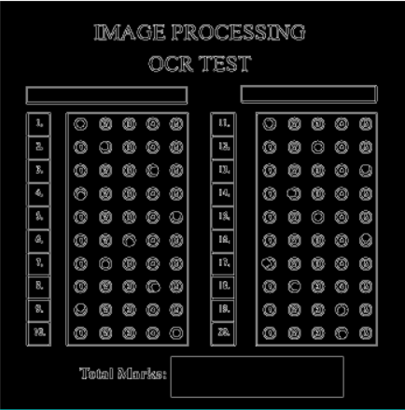
Results
Canny Operator

Slide 10
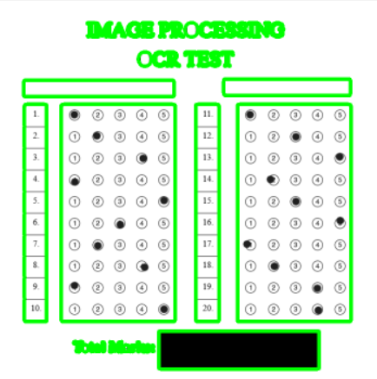
Results
Contour Detection

Slide 11
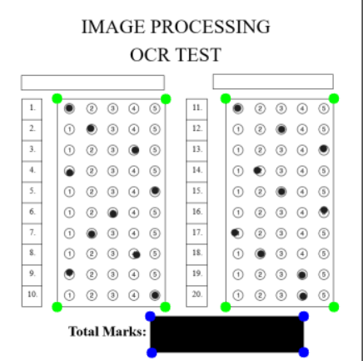
Results
Selecting the main rectangles

Slide 12
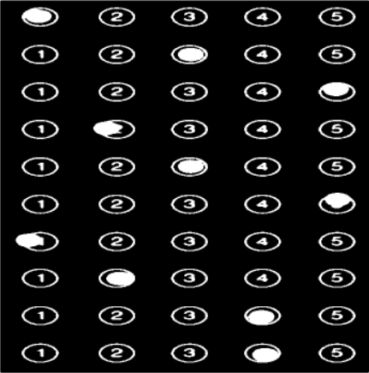
Results
Warp and threshold

Slide 13
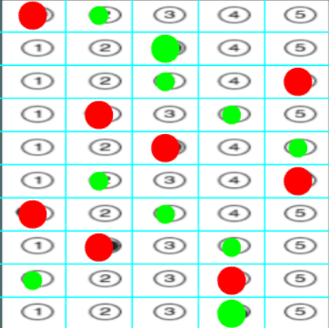
Results
Grid and mark answers

Slide 14
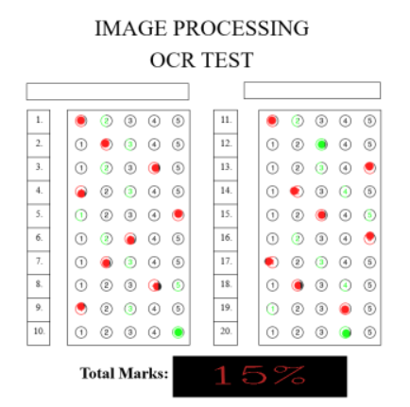
Results
Final result

Slide 15
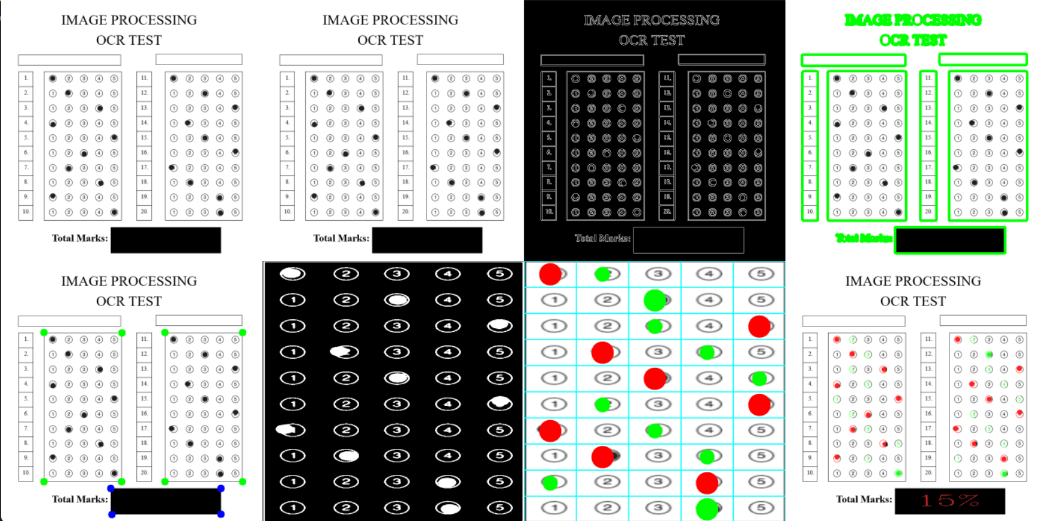
Conclusion
Final result

Slide 16
Conclusion
Challenges
When the image not properly scanned, it’s difficult to identify contours
Moving from MATLAB to python with openCV.

Slide 17
Thanks!
Any questions?

